Slide 1
Publishing Your Community Engaged Scholarship
Diane M. Doberneck, Ph.D.,
Asst. Director, National Collaborative for the Study of University Engagement, Michigan State University
2016 Pen to Paper Writing Retreat
George Williams College, Williams Bay, WI
October 21, 2016

Slide 2
GET ORGANIZED TO WRITE
Notes:
Add an image

Slide 3
Reflect For a Moment
Reflect on moment on why service learning or community engaged scholarship is important to you? Write down your WHY.
What does your writing process look like? Make a sketch if that helps.
What helps YOU adopt an new habit?

Slide 4
The Power of Habit
Set aside regular times to write (this is part of your scholarly work, like teaching or research)
Figure out what works for you
What helps you stick a new habit?
Alone, with friends, some combination?
Notes:
Illustration by: Luc Melanson in the Timonty D. Wilson book review for the New York Times March 9, 2012.
http://www.nytimes.com/2012/03/11/books/review/the-power-of-habit-by-charles-duhigg.html
Found at: http://www.nytimes.com/2012/03/11/books/review/the-power-of-habit-by-charles-duhigg.html

Slide 5
Armature, Details, & Editing
For me:
Initially, big blocks to establish the structure, bones, armature
Then, new writing every day, early, before the day gets to be too hectic (before email)
With clean ups and editing later in the day
Notes:
Image from: http://littlebigfaith.tumblr.com/post/50592402115/making-armatures-there-are-many-ways-to-make
Faith Wong’s sculpture process

Slide 6
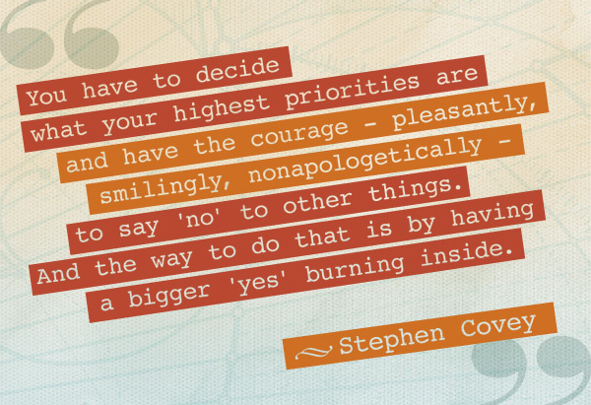
The Art of the Gentle No
Notes:
Image from:
https://lead21ssms.wordpress.com/2013/04/28/the-8th-habit-from-effectiveness-to-greatness/

Slide 7
Where and When to Write
Where can you concentrate, with minimal interruptions?
At your office
At you house
At the coffee shop
Are there times you can block out on your schedule—between semesters, during the summer?
Can you schedule your own writing retreat—a special place, time to get away and concentrate?

Slide 8
Each Time You Write
Start each session with a goal, focus, and work towards it.
Break the bigger project down into small pieces.
Wrap up each session with notes about what to work on next time you write.

Slide 9
Example: Next Time To Do List
Notes:
Example of a “to do list when I pick the manuscript back up”

Slide 10
Example: Track Changes Revision Notes
Notes:
Example of a to do list in the middle of an article

Slide 11
Reflect for a Moment
What are some of your barriers to writing? Name 1-3 barriers.
What strategies might you use to overcome those barriers?
Notes:
Anyone willing to share out?

Slide 12
IMPORTANCE OF SITUATING YOURSELF IN BROADER SCHOLARLY DISCOURSE
Clarifications
Community-Engaged, Community-Placed (Cathy)
Methodology (approach), Methods (tools) (Randy)
CBPR, PAR, AR—don’t worry about distinctions (Randy)
Theory (why), Conceptual framework (what) (Diane) Engaged T&L vs. Community Engaged T&L (Diane)
Academic service-learning, Co-curricular service-learning (Diane)
Notes:
Add an image

Slide 13
Notes:
We will come back to the bottom arrow in a minute

Slide 15
Starting with Foundational Scholarship
Ideally, start your project or writing with a solid literature review, theory, or conceptual framework.
Retrofitting is tough!
What is your study or project’s significance? Does it address a gap? What makes it novel, innovative? How does your work fit/not fit into what else is out there?
Notes:
Image from: http://startline-running-store.myshopify.com/
Randy reminded us yesterday of that Talking Heads song….YOU MAY FIND YOURSELF….

Slide 16
Foundational Scholarship is…
…the body of knowledge that informs and guides your community engagement. It could be from:
from your discipline (or interdisciplinary) scholarship about the issue being addressed.
Scholarship of Engagement.
Scholarship of Teaching and Learning (called SoTL).
Scholarship related to the population affected by the issue.
Scholarship related to the paradigm, method, or approach.
Scholarship related to the collaboration or engagement process used.
Scholarship related to reflection, evaluation, assessment, or lessons learned.
Or any combination.

Slide 17
X
Notes:
If you do not, cannot, or are not linking your community engaged work to foundational scholarship (even as a retro-fit), it’s difficult to call it SCHOLARSHIP….it’s more like flying by the seat of your pants. It’ll be difficult to publish.

Slide 18
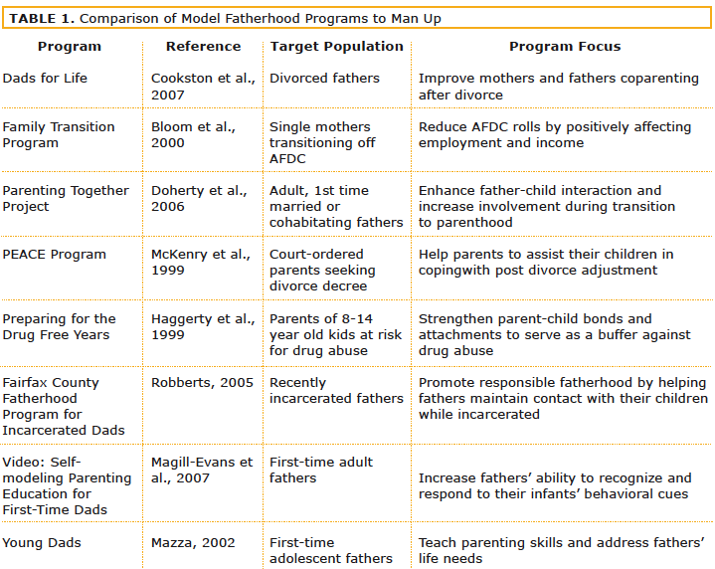
Man Up article in JCES: Example of Foundational Scholarship

Slide 19
Examples: Theoretical Foundations & Conceptual Frameworks
Resources in Your Packet
Crabtree (2008) Theoretical foundations for international service learning (MJCSL) (white)
Demb & Wade (2009) Conceptual model to explore faculty community engagement (MJSCL) (blue)
Wade & Demb (2012) Reality check: Faculty involvement in outreach and engagement. (Journal of Higher Education) (select pages)

Slide 20
Linking Back to Foundational Scholarship
Given your community engagement experience, in your specific context, what aspects of your foundational scholarship held true? Where were there differences?
Remember to discuss the “so what?” or “who cares?” about what you have discovered through your community engagement.
What are the implications for
Future research.
Make links to your delimitations and limitations.
Teaching and learning.
Policy–and at what level.
Practice.

Slide 21
Recognizing & Representing Decision-Making Power and Voice in Your Community-Engaged Process

Slide 22
The Degree of Collaboration Abacus Tool
A visual metaphor to account for community partner voice in decision-making and collaboration responsibilities
Represents balances of power
Complete this together
Notes:
Note: Abacus is accessible.

Slide 23
Abacus Tool: The Sides
One side represents community partner’s voice in the decision-making.
The other side represents university partner’s voice in the decision-making.

Slide 24
Abacus Tool: The Rungs
Rungs represent the steps in collaborative, engagement processes.
They are specific to your type of community engaged scholarship.
Rungs may be re-named to match your project’s steps.
Notes:
Does the stages do not always progress linearly statement go here? I’m thinking it could be deleted here & mentioned on the Cavaeat’s slide later one.
That would make for a cleaner lead in to the next three slides.
Note: Abacus Tool is Accessible.

Slide 25
CE Research Abacus
Step in CE Research Process | Voice & Responsibility
 | Community University
1. Identify community issue(s) & assets
2. Decide on research question(s)
3. Select research design
4. Develop instrument/process
5. Collect data
6. Analyze data
7. Interpret data
8. Critically reflect, incl. limitations
9. Disseminate findings
10. Create academic products
11. Create public products
Notes:
HANDOUTS: One for most types of CES. We still need a good template for CE creative activities and other examples for CE Service and Practice.

Slide 26
CE Teaching & Learning For Credit Abacus
Steps in CE Teaching/Learning Process | Voice & Responsibility
 | Community University
1. Identify community issue(s) & assets
2. Develop learning objectives, outcomes
3. Recruit interested students
4. Match community & students
5. Orient students to community setting
6. Develop assignments/activities
7. Grade/feedback on assignments
8. Evaluate student performance
9. Evaluate partnership
10. Critically reflect on outcomes
11. Create academic products
12. Create public products

Slide 27
CE Teaching & Learning Not for Credit Abacus
Steps in CE Teaching/Learning Process | Voice & Responsibility
 | Community University
1. Identify community issue(s) & assets
2. Identify context—time, setting
3. Understand learners’ needs
4. Identify learning objectives, outcomes
5. Develop learning experiences
6. Provide learning experiences
7. Develop evaluation plan
8. Gather & analyze evaluation data
9. Critically reflect on experiences
10. Revise programming
11. Create academic products
12. Create public products

Slide 28
Abacus Tool: The Beads
Beads indicate which side—the community side or the university side—has more decision-making power and collaboration responsibilities.
More beads indicate more voice and responsibility.
Notes:
Note: Abacus tool is accessible

Slide 29
The Matter of Origins Degree of Collaboration Abacus
Step in CE Research Process | Voice & Responsibility
 | Community University
1. Identify community issue(s) & assets
2. Decide on research question(s)
3. Select research design
4. Develop instrument/process
5. Collect data
6. Analyze data
7. Interpret data
8. Disseminate of findings
9. Create academic products
10. Create public products
Notes:
NOTE: Abacus is accessible.

Slide 30
When To Use The Abacus Tool
Initial discussions with (potential) partners—establish a basic understanding of what the steps are in the process.
Formalizing partnership agreements, including memoranda of understanding—to clarify who has decision-making power and collaboration responsibilities at each stage.
Grant-writing—to use as a visual to demonstrate proposed shared decision-making and collaboration responsibilities.

Slide 31
When to Use the Abacus Tool, continued
Reflective practice mid-way through a project—to clarify how the collaboration is going and ask/reflect on whether initial decision-making and responsibilities might need to be re-negotiated.
Project wrap up, final reflection and reporting—to depict how decision-making and collaboration responsibilities were actually divided (revisions may be needed).
Teaching/learning tool—to help undergraduate and graduate students understand various stages in process and visualize shared decision-making and collaboration responsibilities with the community partners.

Slide 32
When to Use the Abacus Tool, continued
Writing a journal article about the methods, processes, partnership or engagement aspects of your community engaged scholarship
Notes:
Pause: If all of the beads are on the university side of the abacus….what does that mean?
You won’t get into CES4Health
You are likely NOT doing community-engaged scholarship!!!

Slide 33
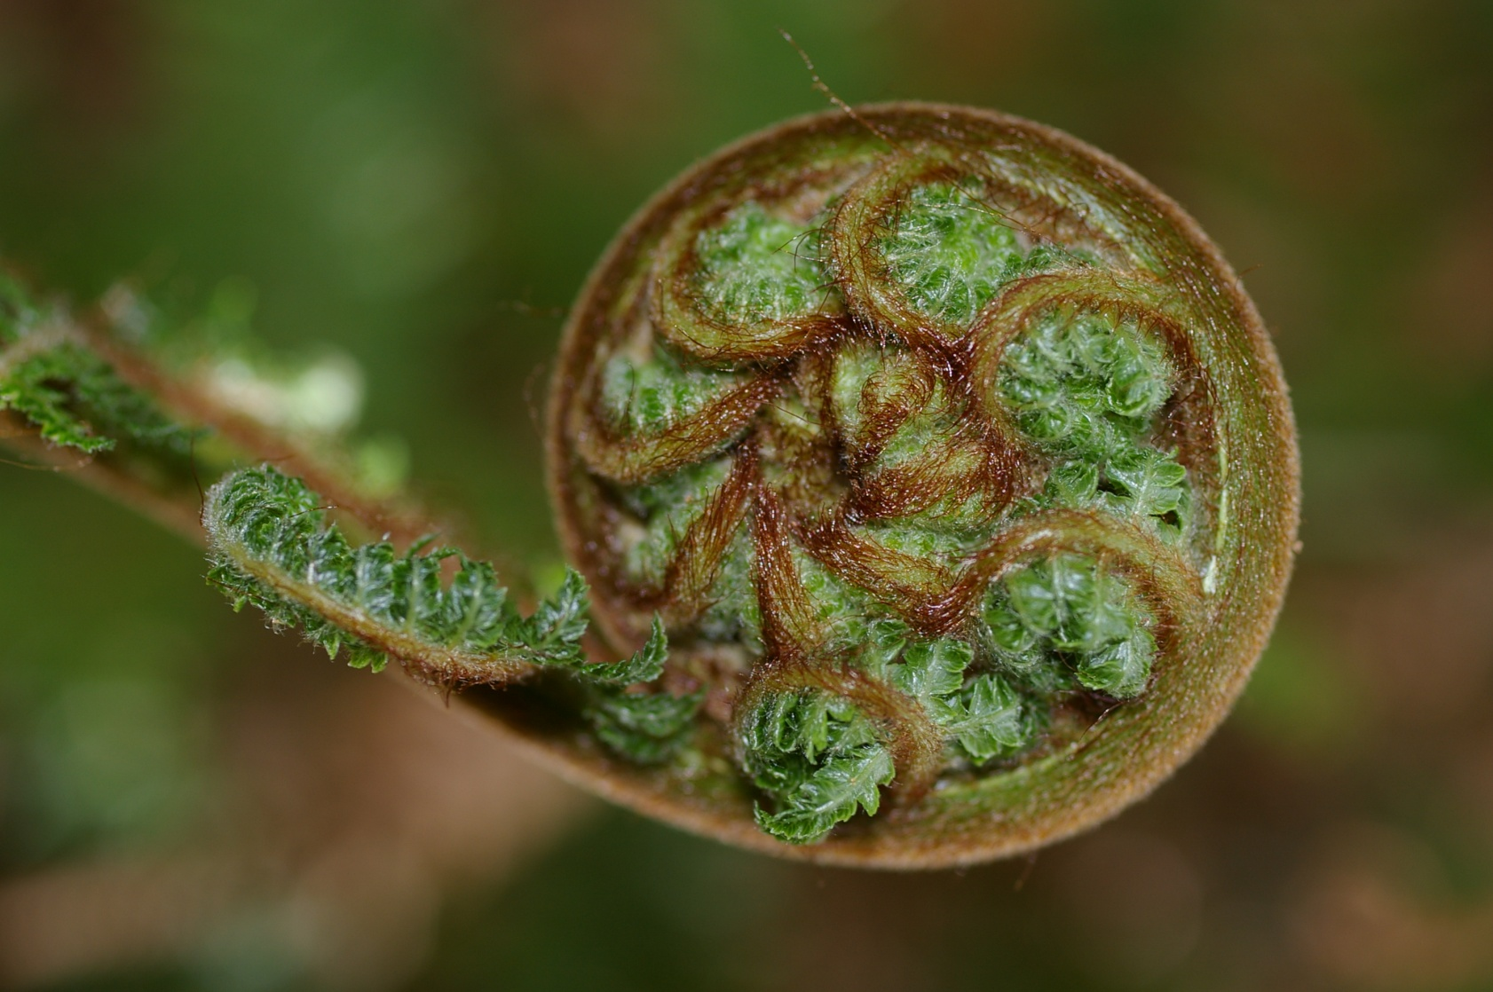
IDENTIFY YOUR LEAST PUBLISHABLE UNITS
Whitney J. Owen “In defense of the least publishable unit” Chronicle of Higher Education, February 6, 2004.
Notes:
Speaker Notes:
Least publishable unit (LPU)
Cynical—but maybe not
Lots of little ones, but no big one
Alternative, builds confidence, more possible in the juggle of early career or early family
Also—democratizes knowledge, getting out there more quickly
Image from:
https://www.google.com/search?q=image+fern+unfurling&biw=1280&bih=913&tbm=isch&tbo=u&source=univ&sa=X&ved=0CB0QsARqFQoTCLyZrdLT9MYCFQHOgAodT98BZw#tbm=isch&tbs=rimg%3ACfF2pcnzTIlRIjhiH_1Azwmt7hqF7x2LITHfmyQBDvn6fKd2-aavjjs6wcmQUZXXhjTd-zKj_16Vl85dAeNFHcLaDjGSoSCWIf8DPCa3uGEdkEOk9vNSjeKhIJoXvHYshMd-YR4CGktRNS8dEqEgnJAEO-fp8p3RFh9aN8cteOTyoSCb5pq-OOzrByETqDqTI0wjoEKhIJZBRldeGNN34R6XoL2gJ8c7AqEgnMqP_1pWXzl0BEqOx7Inh4U9CoSCR40UdwtoOMZEfAcDHxQHMwU&q=image%20fern%20unfurling&imgrc=8XalyfNMiVEvoM%3A

Slide 34
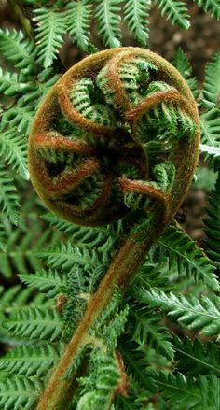
Unfurling Your Project or Experience
Conceptual framework, program theory, or models.
Methods, processes, partnership, engagement.
Program descriptions, case studies.
Findings, results or impacts on
Community.
Community partners.
Students.
Faculty and staff.
Partnership.
Institution.
Critical reflections on the experience, process, critiques, or lessons learned.
Notes:
Image from:
https://www.google.com/search?q=image+fern+unfurling&biw=1280&bih=913&tbm=isch&tbo=u&source=univ&sa=X&ved=0CB0QsARqFQoTCLyZrdLT9MYCFQHOgAodT98BZw#tbm=isch&tbs=rimg%3ACfF2pcnzTIlRIjhiH_1Azwmt7hqF7x2LITHfmyQBDvn6fKd2-aavjjs6wcmQUZXXhjTd-zKj_16Vl85dAeNFHcLaDjGSoSCWIf8DPCa3uGEdkEOk9vNSjeKhIJoXvHYshMd-YR4CGktRNS8dEqEgnJAEO-fp8p3RFh9aN8cteOTyoSCb5pq-OOzrByETqDqTI0wjoEKhIJZBRldeGNN34R6XoL2gJ8c7AqEgnMqP_1pWXzl0BEqOx7Inh4U9CoSCR40UdwtoOMZEfAcDHxQHMwU&q=image%20fern%20unfurling&imgrc=UKvVtEwi8707gM%3A

Slide 35
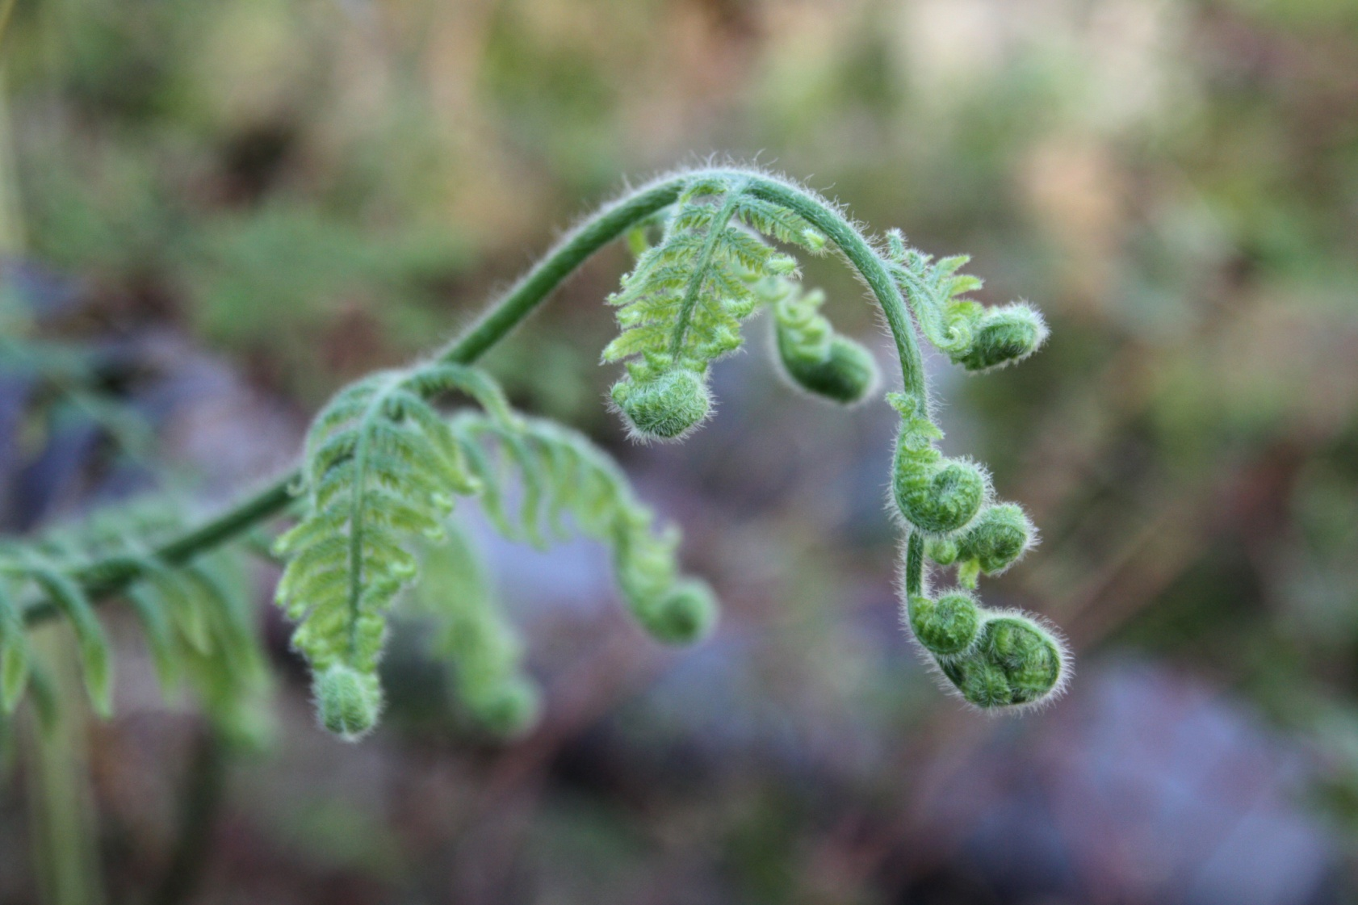
Unfurling Examples
Notes:
Image from:
https://www.google.com/search?q=image+fern+fronds&biw=1280&bih=913&tbm=isch&tbo=u&source=univ&sa=X&ved=0CB0QsARqFQoTCO2T78jU9MYCFceTDQoda-wDXw#imgrc=eKdhod3KVmCTrM%3A

Slide 36
Amy Wade at Ohio State University
Dissertation
Wade, A. (2008). Faculty and the engaged institution: Toward understanding motivators and deterrents for fostering engagement. The Ohio State University.
Journal Article—Community Engagement Journal
Conceptual framework
Wade, A., & Demb, A. (2009). A conceptual model to explore faculty community engagement. Michigan Journal of Community Service Learning 15(2), 5-16.
Journal Article—Disciplinary Journal
Quantitative data
Demb, A., & Wade, A. (2012). Reality check: Faculty involvement in outreach and engagement. The Journal of Higher Education 83(3), 337-366.

Slide 37
Wade’s Dissertation Unfurling Worksheet
Topic | Audience | Type of Article | Potential Journals
Faculty & the engaged institution: Toward understanding motivations and deterrents for fostering engagement. | Disciplinary | Dissertation | (Wade = 1st author)
Thorough literature review leading to a conceptual model of factors influencing faculty engagement | Interdisciplinary CES | Conceptual Framework | Michigan Journal of Community Service Learning (Wade = 1st, Demb = 2nd)
Revised Faculty Engagement Model based on empirical data from one university | Disciplinary Research | Research Results | The Journal of Higher Education (Demb =1st; Wade = 2nd)

Slide 38
Diane’s RPT Study Team
Journal—Community Engagement Journal
Conceptual framework/typology
Doberneck, D. M., Glass, C. R., & Schweitzer, J. H. (2010). From rhetoric to reality: A typology of publicly engaged scholarship. JHEOE 14(4), 5-35.
Journal —Community Engagement Journal
Quantitative data analysis using published typology
Glass, C. R., Doberneck, D. M., & Schweitzer, J. H. (2011). Unpacking faculty engagement: The types of activities faculty member report as publicly engaged scholarship during promotion and tenure. JHEOE 15(1), 7-29.
Journal —Community Engagement Journal
Quantitative data analysis
Doberneck, D. M., Glass, C. R., & Schweitzer, J. H. (2012). Beyond activity, place, and partner: How publicly engaged scholarship varies by intensity of activity and degree of engagement. JCES 4(2), 18-28.

Slide 39
Doberneck’s RPT Study Unfurling Worksheet
Topic | Audience | Type of Article | Potential Journals
Grounded theory influenced study to develop a typology of scholarly faculty work | Interdisciplinary CES | Conceptual Framework | Journal of Higher Education Outreach & Engagement
Applied typology to RPT data to analyze difference in appointment and sociodemographic variables | Interdisciplinary CES | Research Results | Journal of Higher Education Outreach & Engagement
Applied typology to RPT data to analyze difference in intensity of activity, degree of engagement, disciplinary grouping | Interdisciplinary CES | Research Results | Journal of Community Engagement & Scholarship

Slide 40
Diane’s Dance Exchange Research Team
Journal article—Community Engagement Journal
Critical Reflections
Doberneck, D. M., Miller, P. K., & Schweitzer, J. H. (2012). Sometimes there are no notes: An auto-ethnographic essay of a collaboration at the engagement interface. JHEOE 16(3), 55-83.
Journal article—Science Education Journal
Quantitative data analysis (revise & resubmit)
Miller, P. K., Doberneck, D. M., & Schweitzer, J. H. (in preparation). The Matter of Origins: Understanding physics through an art/science/engagement performance. Informal Science Education: Part B.
Journal article—Community Engagement Journal
Qualitative data analysis (early stages)
Doberneck, D. M., Miller, P. K., & Schweitzer, J. H. Pretend you are a scientist: Qualitative analysis of napkin notes at an engagement tea about physics.

Slide 41
Doberneck’s Dance Exchange Research Team Unfurling Worksheet
Topic | Audience | Type of Article | Potential Journals
Auto-ethnography about experience of partnering with Dancers & NSF on CES project | Interdisciplinary CES | Reflection | Journal of Higher Education Outreach & Engagement
Informal science learning outcomes on audience members and local dancers (in process) | Interdisciplinary Research | Results | International Journal of Science Education, Part B: Communication and Public Engagement
Qualitative analysis of data from one data collection tool—napkin note (in process) | Interdisciplinary Methods | Methods | Journal of Community Engagement & Scholarship

Slide 42
Franz’s “How Farmers Learn” Project
Journal article—Disciplinary Journal
Findings, results, impacts
Franz, N. (2010). How farmers learn: Implications for Agricultural Educators. Journal of Rural Social Sciences, 25(1), 37-59.
Journal article—Community Engagement Journal
Findings, results, impacts—Research Brief
Franz, N. (2010). Farmer, Agent, and Specialist Perspectives on Preferences for Learning Among Today’s Farmers. Journal of Extension, 48(3).
Journal article—Methods Journal
Critical reflections
Piercy, F.P., Franz, N., Donaldson, J.L., & Richard, R. F. (2011). Consistency and change in participatory action research: Reflection on a focus group study about how farmers learn. The Qualitative Report, 16(3), 820-829.

Slide 43
Franz’s Unfurling Worksheet
Topic | Audience | Type of Article | Potential Journals
How famers learn: implications for agricultural education | Discipline Research | Results, impacts, findings | Journal of Rural Social Sciences
Farmer, agent, and specialist perspectives on preferences for learning among today’s farmers | Interdisciplinary Research | Research Brief | Journal of Extension
Consistency and change in participatory action research: Reflection on a focus group study about how famers learn | Interdisciplinary Methods | Reflections | The Qualitative Report

Slide 44
Unfurling Your CES Project Worksheet
Topic | Audience Disciplinary Research SoTL CES Interdisciplinary Research Methods SoTL CES | Type of Article Conceptual framework, program theory, models Program description, case study Methods or processes for partnership or engagement Results or Impacts on community, students, faculty, organization, or institution Reflections, critiques, lessons learned | Potential Journals

Slide 45
Activity 1: Disciplinary Journal Search
Consider journals you are familiar with (or identify a new one)
What disciplinary journal(s) publish community engaged scholarship?
What kind(s) of articles do they publish?
Conceptual frameworks, paradigms, program theory, models
Methods, processes, partnerships, engagement
Program descriptions, case studies
Results or impacts
Critical reflections, lessons learned
What else?
Be ready to report out.

Slide 46
Prioritize After You’ve Unfurled
What is “low hanging fruit”?
What are you most passionate about?
What is a breakthrough idea/significant contribution?
What “counts” for you?
Peer reviewed journal articles.
Chapters in edited volumes.
Books.
Where will it count the most?
Advice from senior mentors.
Advice from recently tenured colleagues.

Slide 47
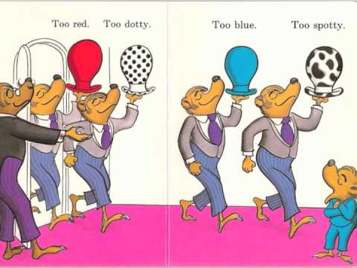
FINDING YOUR “JOURNAL FIT”

Slide 48
Selecting an Interdisciplinary CES Journal for Your Article
Resources in Your Packet
Annotated List of Interdisciplinary CES Journals
Interdisciplinary CES Journal Comparison Table (big handout)
Exploring Journals Handout (purple)
Unfurling worksheet (white, with purple table)

Slide 49
Key Considerations At the Start
Who is the audience for the article?
Fellow Academics or Researchers
Higher Education administrators
Senior leaders—institutional change
SLCE professionals
Policy-makers, legislators
Community-based practitioners, professionals in the field
Community leaders
Community members, members of the general public
NOTE: publish in non-peer reviewed venues too
Notes:
New Slide—On your Comm Partner Handout
NOTE: You should select the journal BEFORE you write the manuscript b/c manuscripts have different word counts, different sections, different length of those sections, reference lengths, and overall formats.
Writing a manuscript first….and then shopping around for a journal often wastes time…due to longer, longer revisions.
Image from: https://www.google.com/search?q=purpose+image&biw=1920&bih=969&tbm=isch&tbo=u&source=univ&sa=X&ved=0ahUKEwirkcLtjK_MAhUFvoMKHbX6BqAQ7AkIMA#imgrc=HwtHOj8Rf0YZZM%3A

Slide 50
More Key Considerations
What is the purpose of the article?
Conceptual frameworks, program theory, models
Methods, processes, partnerships, engagement
Program descriptions, case studies
Findings, results or impacts on various groups
Critical reflections, lessons learned
What else?
What journal is most appropriate to achieve the purpose for the audience? Disciplinary or Interdisciplinary?

Slide 51
Read & Explore
Familiarize yourself with many journals.
Different kinds of articles within each journal.
Skim for inspiration on topics, methods, data presentation.
Figure out which journals publish which kinds of articles and what options will work for you.
Disciplinary journals.
Scholarship of teaching and learning journals in your discipline.
Interdisciplinary scholarship of teaching and learning journals.
Research, evaluation, or methods journals.
Scholarship of engagement journals in your discipline.
Interdisciplinary community engagement journals.
Consider how community partner voices are represented in the journal articles.
Notes:
Handout: Community Partner Voice from a CBPR article
Possible Activity: put newsprint sheets up w/different headings
Disciplinary journals
SoTL
Research Methods

Slide 52
Other Finding “Your Fit” Considerations
Examine the style, tone
I/we or the researchers/the community partners
Consider other aspects of the publishing
Photos, embedded links, instruments.
Preferences for community partners or students as co-authors.
Qualitative, quantitative, mixed methods.
Examine the article length, standard sections, and length of each section.
Introduction—1-2 paragraphs or 1-2 pages?

Slide 53
Other Finding “Your Fit” Considerations
Read the bibliography thoroughly.
How many citations?
How many citations focus on big authors in your field?
How many on methods?
Include 3-5 citations from the journal you want to publish in (shows you are a regular reader).
Follow the Authors Guidelines/ Instructions.
Revisit at end of your writing to adjust for drift.

Slide 54
Activity 2: Practice Unfurling a Project
Who is your audience? What kinds of journals might you publish your articles in?
Disciplinary Journals
Research
Scholarship of Teaching & Learning (SoTL)
Community Engaged Scholarship (CES)
Interdisciplinary Journals
Research
Methods
Scholarship of Teaching & Learning (SoTL)
Community Engaged Scholarship (CES)
What kinds of articles might you write?
Conceptual framework, program theory, or models.
Methods or processes for partnerships or engagement
Program descriptions, case studies
Findings, results or impacts
Critical reflections, critiques, or lessons learned

Slide 55
Journal Exploration and Deeper Exploration Worksheet
Still Looking….
Just Right!

Slide 56
More Resource for Unfurling & Publishing
Resources in Your Packet
Franz (2011) Tips for constructing promotion & tenure dossier that documents engaged scholarship endeavors (JHEOE)
Franz worksheet
IARSLCE Research Review Sheet (salmon)
JHEOE Research Review Sheet (salmon)
MJSCL Review Sheet (salmon)
Bordeaux & et al (2007) Guidelines for Writing Manuscripts (blue)
Anafara & et al (2002) Qualitative analysis on Stage (white)

Slide 57
What’s Unique about Publishing Community Engaged Scholarship?
Community partner voice and perspective
Process of partnering or engagement
extent of decision-making, roles
Outcomes for partnership and community partners

Slide 58
Plan Ahead (Smith & et al, 2010, pg. 1124)
Plan ahead for the organizational structure of the article
Adapt conventional organizational headings, or
Consider deriving organizational structure from project design elements or emergent themes, or
Consider a chronological or narrative framework.

Slide 59
Convey the Key Elements of the Project (Smith & et al, 2010, pg. 1124)
Convey the Key Elements of the Project.
How was the project initiated?
What was the project’s timeframe?
Who were the participants and/or co-researchers?
What was the extent of their participation or and the nature of their roles?
What was the process within and/or the methodology of the project?
What were the project outcomes and/or emergent actions?
What comes next (if the project is on-going)?
Consider charts, timelines, tables, or other graphics to convey part or all of the project design.

Slide 60
Convey the Experiences of the Co-Researchers (Smith & et al, 2010, pg. 1124)
Convey the Experience of the Co-Researchers
Pay attention to who is writing the article and how their voices and experiences are represented.
Pay attention to who is not writing the article and how their voices and experiences are represented.
What were the personal outcomes of the project?
NOTE: or the experience of community partners as Co-Teachers and Co-Learners, in CE Teaching & Learning

Slide 61
Address Challenges, Pitfalls, & Limitations (Smith & et al, 2010, pg. 1124)
Address challenges, pitfalls & limitations.
What were they?
How were they managed?
What can we learn?
About partnerships
About the project.
NOTE: Ethical issues fall into this category. Remember we all have an obligation to go above and beyond what the federal regulations mandate through IRB.

Slide 62
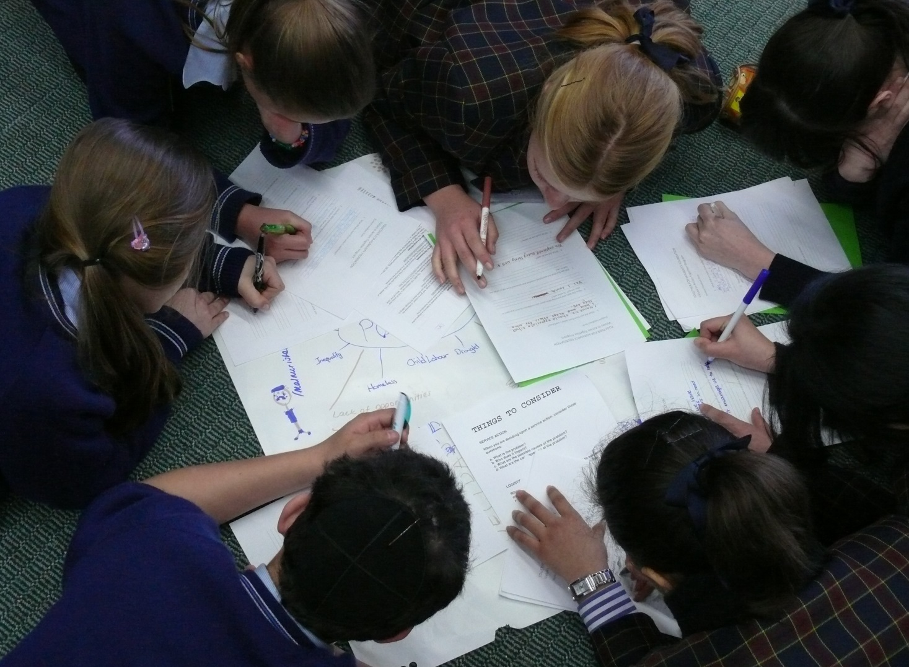
WRITING WITH COMMUNITY PARTNERS
Notes:
See HANDOUT & CBPR article! Talk through main points
Image from: http://www.nikkiwoodsmedia.com/5-valuable-reasons-join-establish-writers-community/

Slide 63
Common Sections for Community Partner Contributions
Introduction (or sometimes in beginning of the methods section).
Context in which the community-campus partnership took place
Definition of community/communities served
History and structure of the community-campus partnership
Community partner role and contribution to the methods, incl. how, when, and where community partners had a voice in the process.
Interpretation of the data from the community partner perspective.
Discussion of the results and their implications for community practice.
What else?

Slide 64
Article Idea Chart For use w/Com Partners and Teams
Topic | Author(s) | Data Source | Proposed Journal | Date Idea Claimed | Action/ Progress | Submission
Forchuck & Meier (2014)

Slide 65
Article Idea Example From Article
Topic | Author(s) | Data Source | Proposed Journal | Date Idea Claimed | Action/ Progress | Submission
Fairness & social justice | Benbow Rudnick Forchuck Edwards | Yr 1 Open ended | Disability & Society | 16 July 2012 | Submitted | 7 April 2013
CURA impact | Hall Perry Forchuck | Yr 1 Partner Interview | Action Research Journal | 23 Jan 2012 | Paper complete Editing | Aim: 1 Sept 2013
Stigma | Csiernik Forchuck Edwards Meier | Yr 1 Stigma Scale | Social Work Journal | 10 Sept 2012 | Writing phase | Aim: 1 Sept 2013
Forchuck & Meier (2014)

Slide 66
MANAGING THE WRITING, SUBMISSION, & REVISION PROCESS

Slide 67
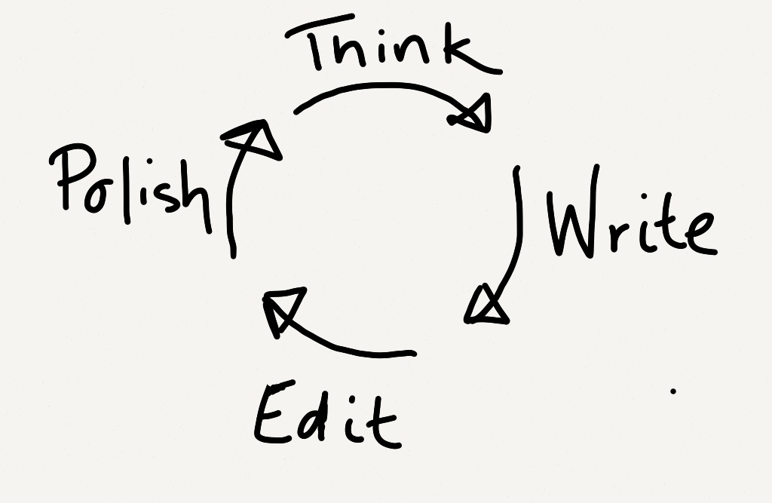
PHASE YOUR WRITING
Phase 1: Think through the type of article, purpose, sections. Identify your journal.
Phase 2: Write the ideas down, just get them down. Write but do not edit at the same time. Save edits for later.
Phase 3: Edit & Revise.
Phase 4: Polish. Have an outside reader one last time.
Notes:
In the final phase, go back and look at the Instructions to Authors to double check that your article hasn’t “drifted” during the multiple revisions.

Slide 68
LaMott’s Advice
“Almost all good writing begins with terrible first efforts. You need to start somewhere.” p.25

Slide 69
Example: Tracking Progress on Multiple Research to Writing Projects

Slide 70
Press Submit
Write, edit, & polish. Submit the best writing you can because some reviewers cannot read past poor grammar (Randy).
Have someone outside of your field read it for clarity (Cathy).
Get professional editing support (Cat).
https://www.google.com/#q=jcehe+publication+roadmap

Slide 71
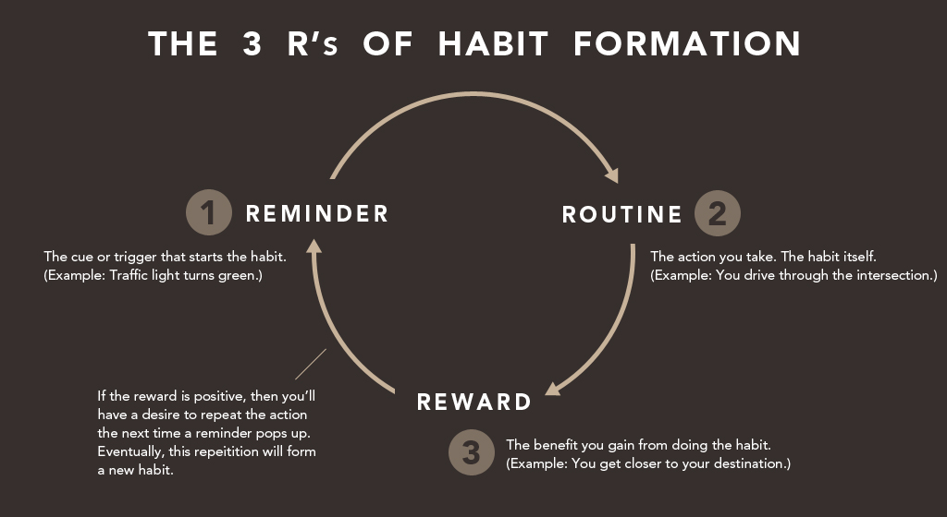
Celebrate

Slide 72
Revise and Resubmit
Read the letter. Weep. Gnash teeth. Bury it.
Get it back out. Make an excel or word file to manage the revisions.
Extract the suggestions from the editor & reviewers.
Re-arrange the revisions in a logical order.
Decide how to respond to each revision.
Tackle revisions, one by one.
Use your file (from #2) to write the cover letter to the editor.
Double check.
Do a final read through.
Re-submit.
Notes:
Information taken from: http://getalifephd.blogspot.com/2011/03/how-to-respond-to-revise-and-resubmit.html

Slide 73
Example: Revise & Resubmit Table

Slide 74
Example: Edited Words and Xs Revision
Notes:
Example of how I do edits….I mark edits during quiet, concentrating times. Then I make the edits while half way watching TV in the evenings. Using the X marked systems helps me keep track of where I am in the editing process.
This is SUPER helpful with group writing & editing. I might meet with my statistics guy, who will suggest some changes…and then a graduate student who might suggest other changes. I might think of something when I’m folding laundry…all of that needs to be kept track of, edited, and changed in the manuscript.
You might use google.docs instead…but you need to make sure you are not all writing & editing at the same time.

Slide 75
Celebrate Again
Send it your collaborators with a thank you note.
Share it with peers and colleagues (don’t worry—it’s not shameless self-promotion)—especially those whom you know might be interested in the topic or who might some day cite it.
Do something nice for yourself. This is part of the “reward” that helps motivate the new habit. It’s also good self-care.
Remember this helps you reconnect & celebrate your WHY!

Slide 76
Reflect for a Moment
What kind of celebration means the most to you? Name 3-5 ways that you find fulfilling.

Slide 77
More Resources
On-Line Tutorials From Elsevier Journal Publisher
https://www.elsevier.com/connect/tutorial-getting-your-paper-noticed

Slide 78
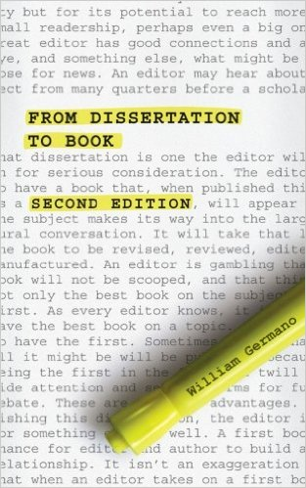
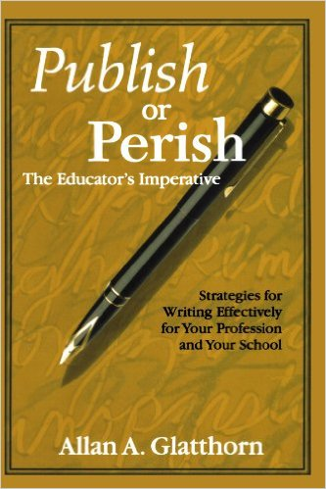
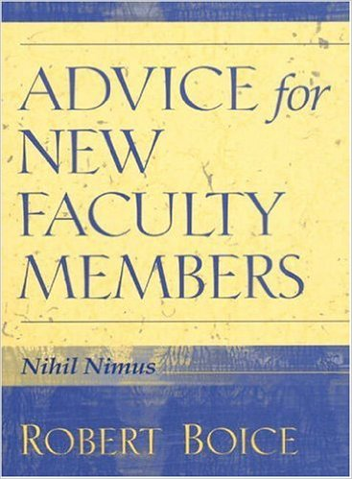
More Resources, Continued

Slide 79
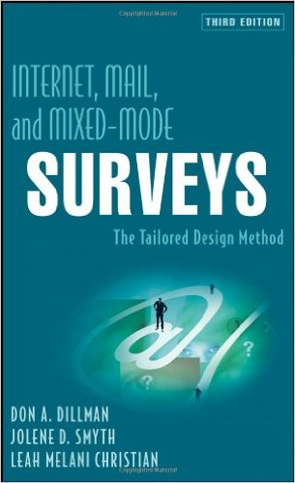
More Resources from P2P Colleagues

Slide 80
Penn State (Free) Resource on Publishing
http://sites.psu.edu/pubhub/

Slide 81
Peer Review for Non-Journal Articles

Slide 82
Community Engagement Friendly Book Publishers—Stylus & Campus Compact

Slide 83
MSU Press

Slide 84
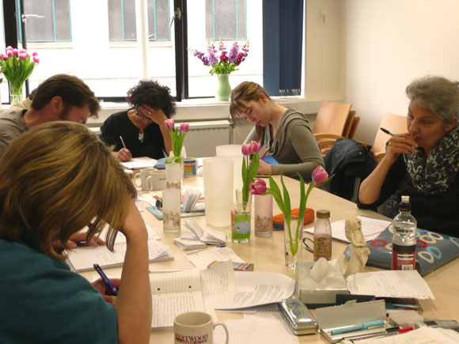
Is a Writing Group For You?
Find friends and colleagues committed to writing.
Establish ground rules.
Idea number of people?
How often to meet?
What do you write?
How often to you share to give/receive feedback?
How far in advance does the work need to be shared?
Where do you meet to write?
Who facilitates?
Celebrate and support one another’s success.
Notes:
Nikki Woods’ 5 Reasons to Join a Writing Community
Inspiration
Intellectual Growth
Critical Thinking
Exposure
Family
See: http://www.nikkiwoodsmedia.com/5-valuable-reasons-join-establish-writers-community/

Slide 85
Is On-Line Writing Support for You?
Editing support
Grammarly.com (Cat suggested this)
National Center for Faculty Diversity and Development
http://www.facultydiversity.org/
Online mentoring, multiple career stages
14 day writing challenges
Academic Coaching and Writing
http://www.academiccoachingandwriting.org/academic-writing

Slide 86
What other support is available to you?
Other Supports
Faculty & Organizational Development Office
Center for Teaching and Learning
Subject Area Libraries

Slide 87
Questions and Answers
Thank You!
Notes:
DD slide

Slide 88
References
Ahmed, S. M., & Palermo, A. S. (2010, August). Community engagement in research: Frameworks for education and peer review. American Journal of Public Health 100(8), 1380-1387.
Anfara, V. A., Brown, K. M., & Mangione, T. L. (2002). Qualitative analysis on stage: Making the research process more public. Educational Research 31, 28-38.
Belcher, W. L. (2009). Writing your journal article in 12 weeks. Thousand Oaks, CA: Sage Publications.
Bordeaux, B. C., Wiley, C., Tandon, S. D., & Horowitz, C. R. (2007). Guidelines for writing manuscripts about community-based participatory research for peer-reviewed journals. Progress in Community Health Partnerships: Research, Education, and Action 1(3), 281-288.
Caulley, D. N. (2008). Making research reports less boring: The techniques of writing creative nonfiction. Qualitative Inquiry 14(3), 424-449.
Forchuk, C., & Meier, A. (2014). The article idea chart: A participatory action research tool to aid involvement in dissemination. Gateways: International Journal of Community Research and Engagement 7(1), 157-163.

Slide 89
References, Continued
Franz, N. K. (2011). Tips for constructing a promotion and tenure dossier that documents engaged scholarship endeavors. Journal of Higher Education Outreach and Engagement 15(3), 15-29.
Goodson, P. (2012). Becoming an academic writer: 50 exercises for paced, productive, and powerful writing. Thousand Oaks, CA: Sage Publishers.
LaMott, A. (1995). Bird by bird: Some instructions on writing and life. Harpswell, ME: Anchor.
Owen, W. J. (2006, February 6). In defense of the least publishable unit” Chronicle of Higher Education.
Smith, L., Rosenzweig, L., & Schmidt, M. (2010). Best practices in the reporting of participatory action research: Embracing both the forest and the trees. The Counseling Psychologist 38(8), 1115-1138.
Thomson, P., & Kamler, B. (2012). Writing for peer reviewed journals. New York, NY: Routledge.
Zaruba, K. E., Toma, D., & Stark, J. S. (1996). Criteria used for qualitative research in the refereeing process. The Review of Higher Education 19(4), 435-460.

